Slide 1
WELCOME

Slide 2

A Model For Investigating Cloud Computing (Iaas) In Data Center Performance And Qos
Submitted by
G.REKHA ,
134C1D5808.
Under the Esteemed Guidance of
Mr. G.LAKSHMI KANTH , M.Tech
Assoc. Professor & HOD,
CSE department.
SREE RAMA ENGINEERING COLLEGE

Slide 3
CONTENTS
INTRODUCTION
PROBLEM DEFINITION
ABSTRACT
EXISTING SYSTEM
DISADVANTAGES
PROPOSED SYSTEM
ADVANTAGES
ARCHITECTURE
MODULES
REQUIREMENTS
UML DIAGRAMS
SCREEN SHOTS
CONCLUSION

Slide 4
INTRODUCTION
What is Cloud Computing System?
Services of Cloud Computing System:
SaaS
PaaS
IaaS

Slide 5
PROBLEM DEFINITION
In cloud environment the server utilization is not properly maintained.
if the request limit rises immediately, this may lead to crash all the active servers at a time.

Slide 6
ABSTRACT
Here I proposed a model which maintains cloud utilization properly .
VM live migration
Cloud federation
Here Several performance metrics are defined and evaluated.
Here it uses SRN’s.
Here it handles all types of requests.
Here a resiliency analysis is also provided.

Slide 7
EXISTING SYSTEM
Based on SLA’s they were predicting the costs/benefits.
Mainly implemented in traditional distributed systems.

Slide 8
DISADVANTAGES
It fallows Black Box approach.
Handles only uniform requests.
Here VM live migration and cloud federation is not possible.
Simulation does not allow to conduct comprehensive analyses of the system performance.

Slide 9
PROPOSED SYSTEM
In this paper, an analytical model is presented, based on Stochastic Reward Nets (SRNs).
it enables the infrastructure elasticity.
Here low level details are easily integrated with cloud based actions.
An exhaustive set of performance metrics are defined regarding both the system provider and the final users.

Slide 10
ADVANTAGES
Here random requests are processed.
The elasticity of system resources is achieved.
Server utilization is properly maintained.
All the system parameters are investigated.
It allows system managers to study the better solution.

Slide 11
ARCHITECTURE

Slide 12
MODULES
System Queuing.
Scheduling Module.
VM Placement Module.
Federation Module.
Arrival Process.

Slide 13
REQUIREMENTS
SOFTWARE REQUIREMENTS
Operating System - Windows Family
Coding Language - JAVA/J2EE
IDE - Eclipse
Database - MySql 6.0

Slide 14
REQUIREMENTS(cont..)
HARDWARE REQUIREMENTS
Processor - Pentium IV
Speed - 2.4 GHz
RAM - 512MB
Floppy Drive - 1.44 Mb.
Hard Disk - 40 GB
Monitor - 15 VGA Colour.
Key Board - Standard Windows

Slide 15
UML DIAGRAMS

Slide 16
USE CASE DIAGRAM

Slide 17
SEQUENCE DIAGRAM

Slide 18
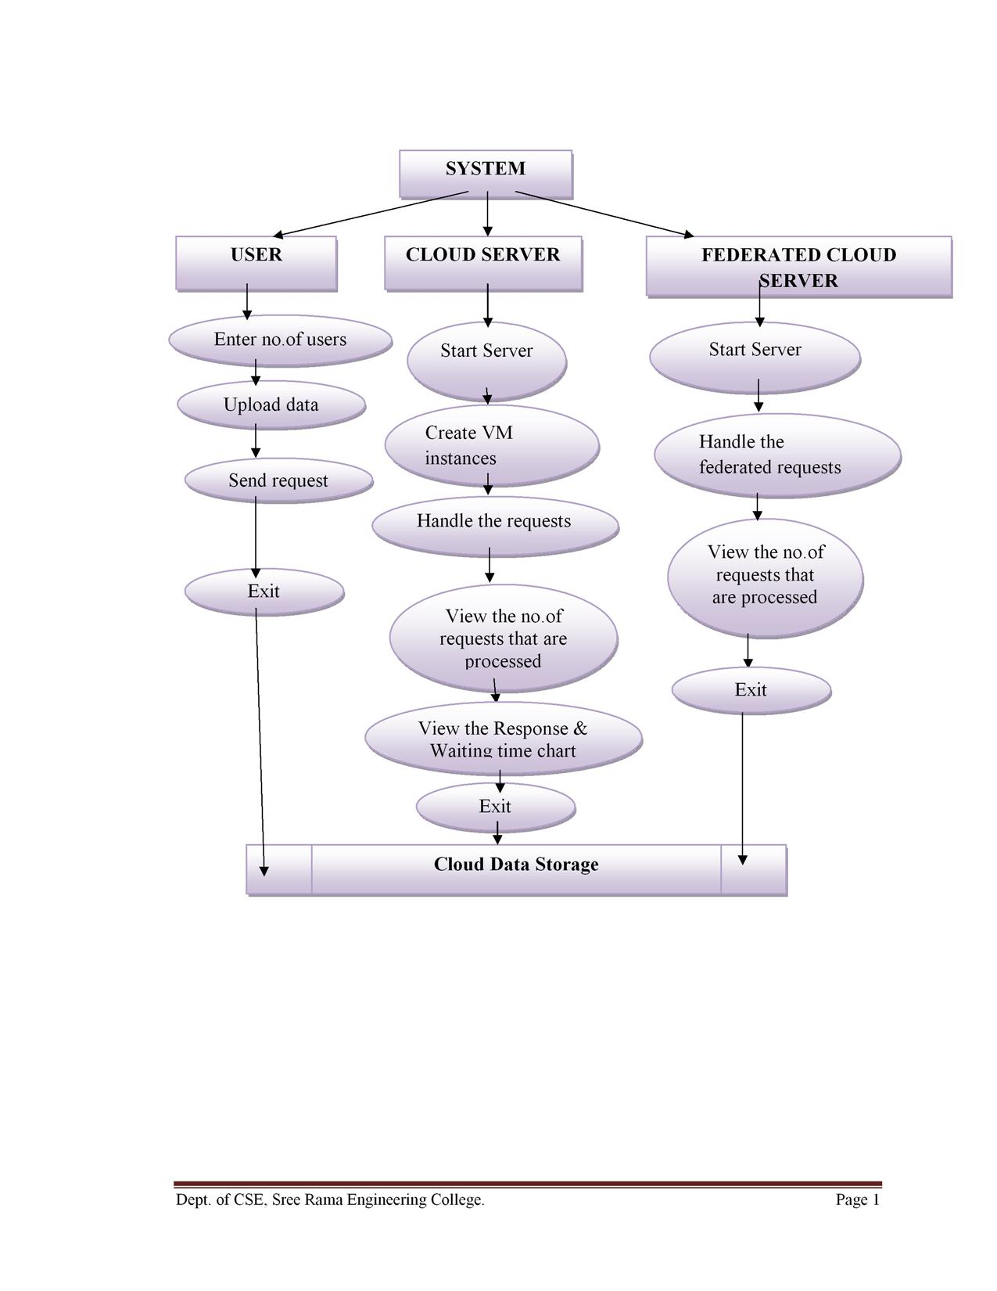
DATA FLOW DIAGRAM

Slide 19
SCREEN SHOTS

Slide 20
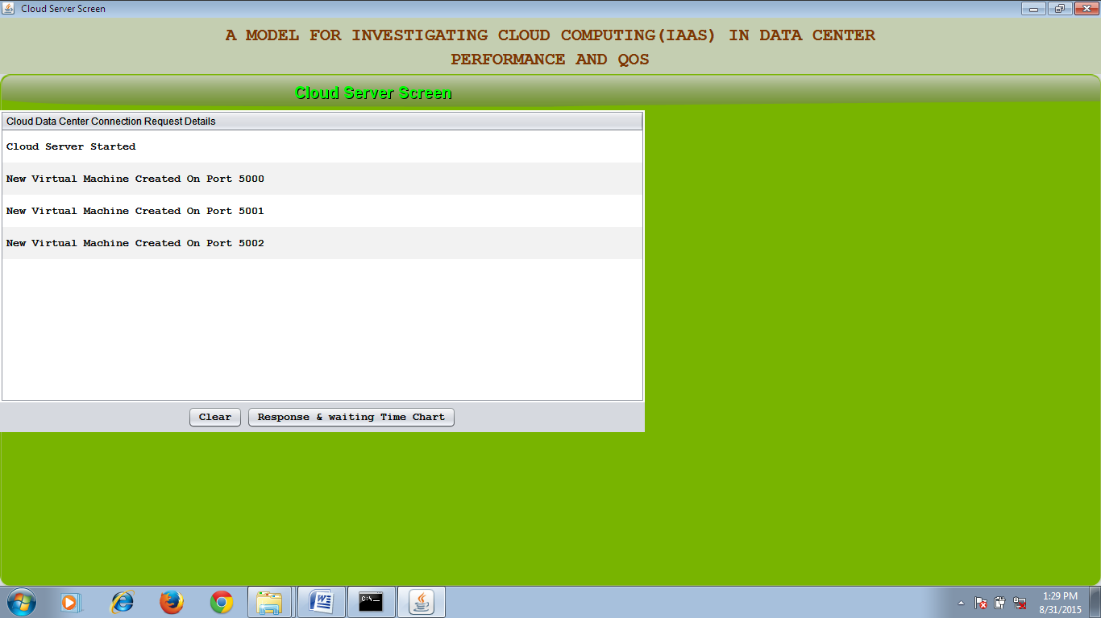

Slide 21
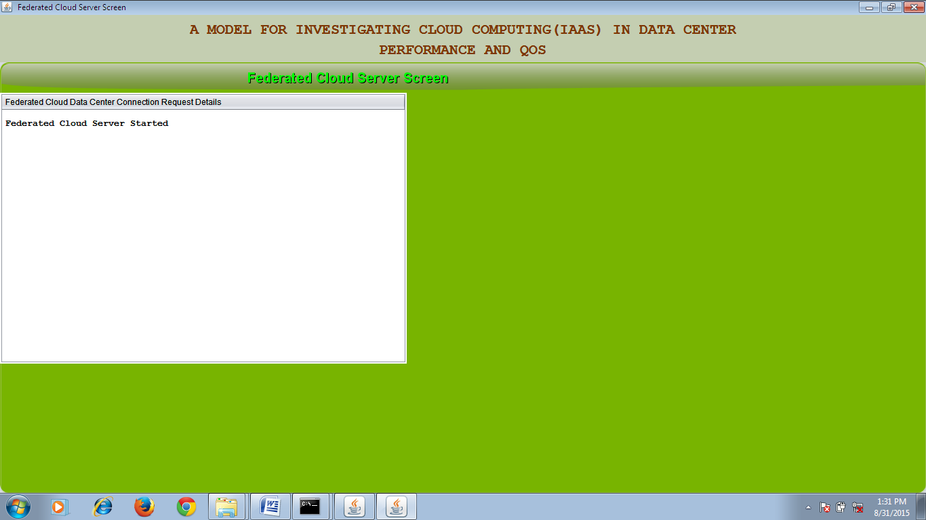

Slide 22
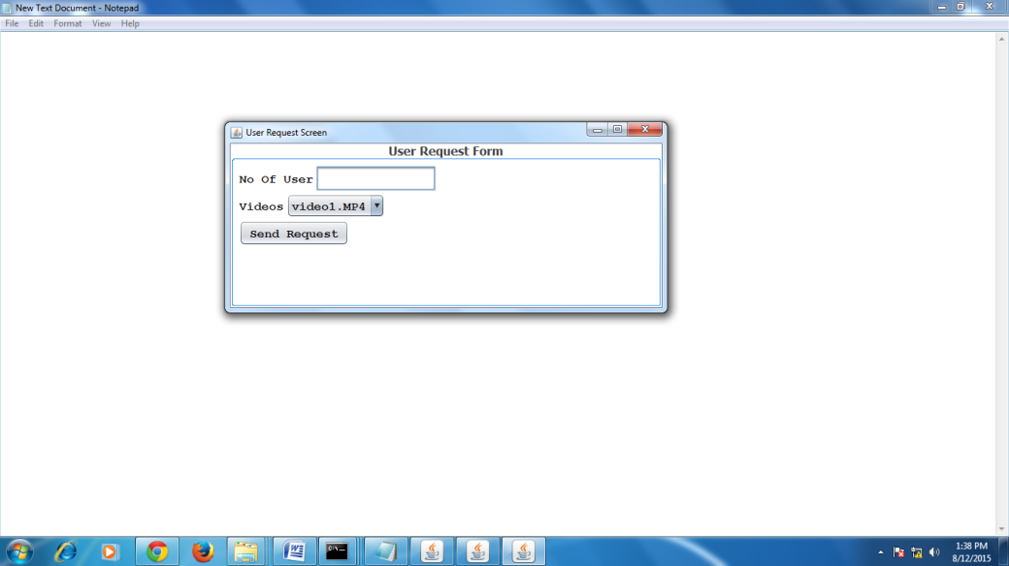

Slide 23
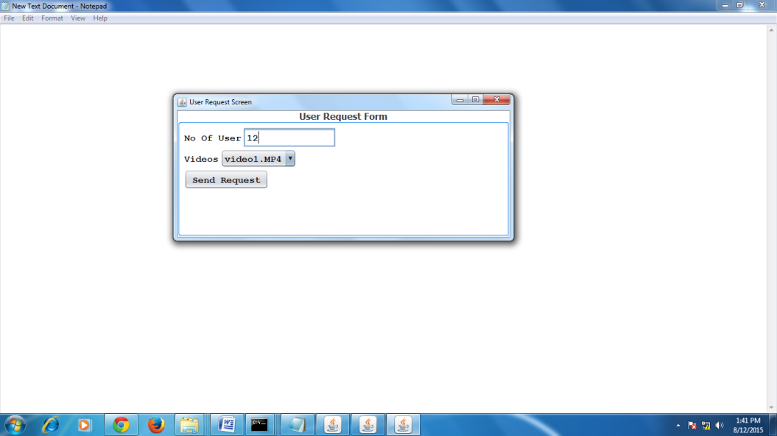

Slide 24
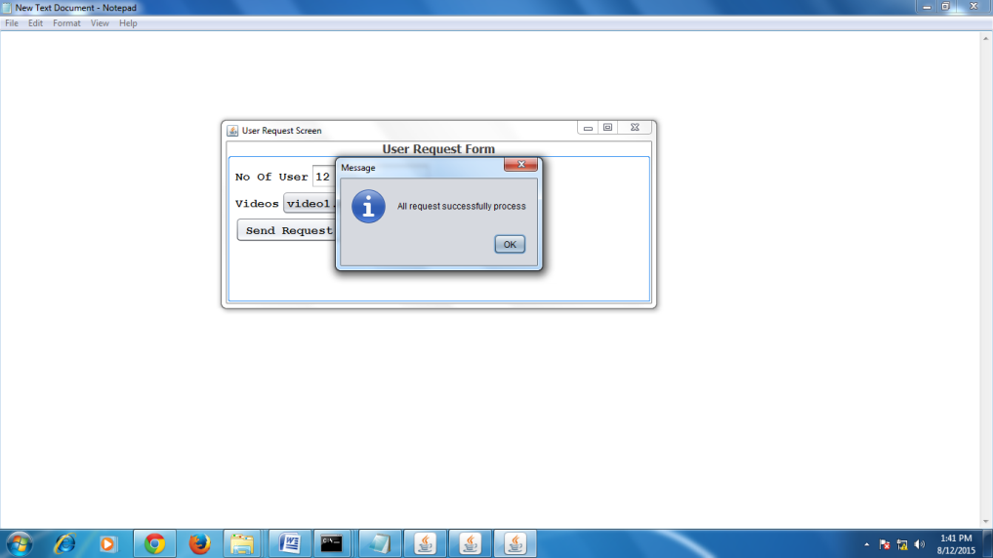

Slide 25
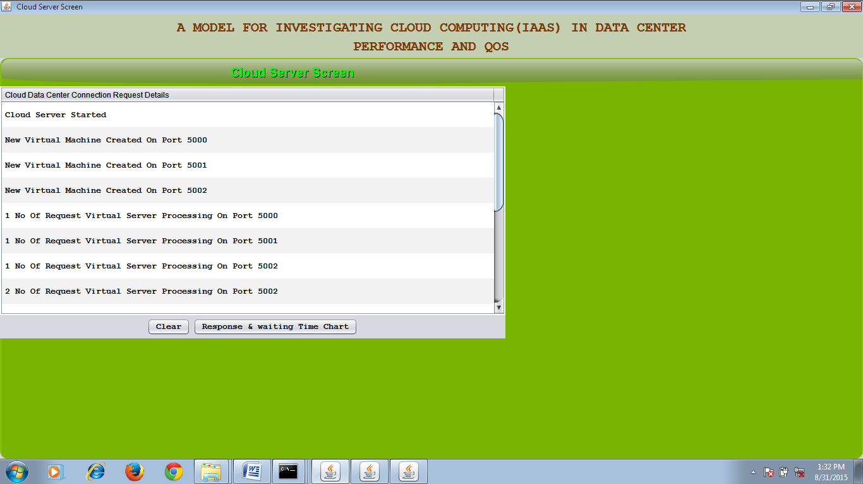

Slide 26
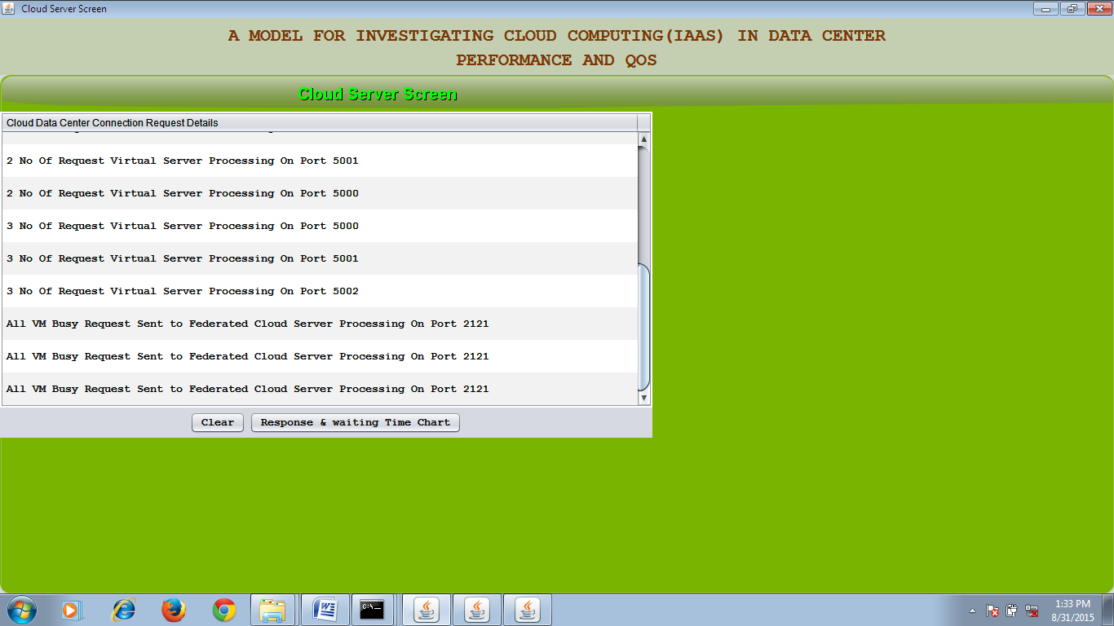

Slide 27
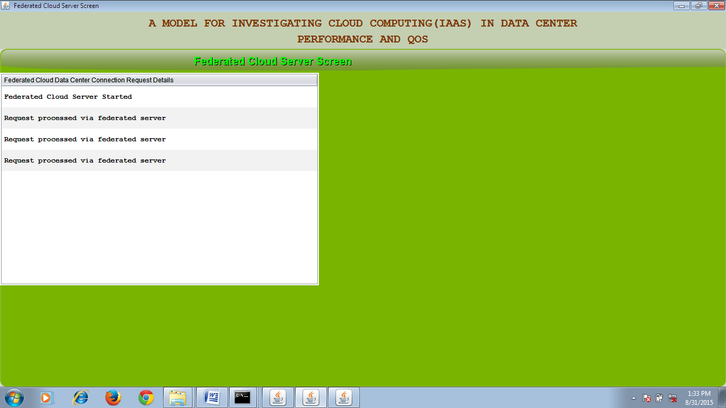

Slide 28
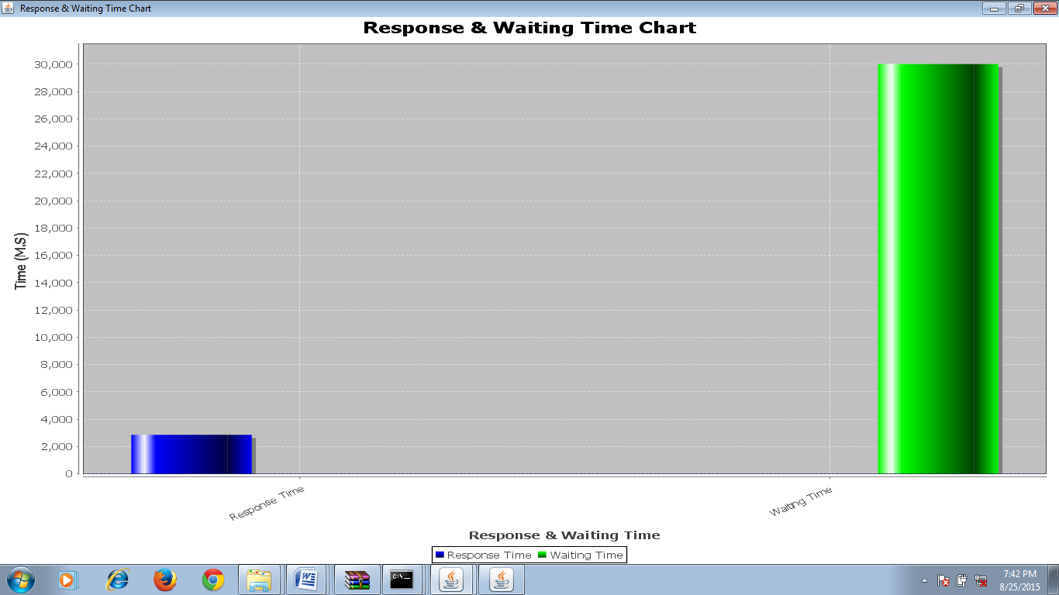

Slide 29
CONCLUSION
In this paper, I have presented a model to evaluate the performance of an IaaS cloud system. Several performance metrics have been defined, such as availability, utilization, and responsiveness, allowing us to investigate the impact of different strategies on both provider and user point of views. In a market-oriented area, such as the cloud computing, an accurate evaluation of these parameters is required to quantify the offered QoS and opportunely manage SLAs.

Slide 30

THANK ‘U’

